Slide 1

Using Machine Learning to Predict Heart Disease
Group 2
Yonatan Gorin
Desiree Joseph
BethAnn Wilde
June 12, 2023

Slide 2

Heart disease is the leading cause of death for men, women, and people of most racial and ethnic groups in the United States. One person dies every 33 seconds in the United States from cardiovascular disease. About 695,000 people in the United States died from heart disease in 2021—that’s 1 in every 5 deaths. Heart disease cost the United States about $239.9 billion each year from 2018 to 2019. This includes the cost of health care services, medicines, and lost productivity due to death. Heart Disease Facts | cdc.gov

Slide 3
The process of using Machine Learning to Predict Heart Disease
Found dataset related to heart disease
Exploratory data analysis to understand different factors and relationships to features and heart disease
Created Machine Learning models to Predict Heart Disease
A look at the results of Predicting Heart Disease

Slide 4
Machine Learning and Heart Disease Dataset
Kagger Heart Disease: This data set dates from 1988 and consists of four databases: Cleveland, Hungary, Switzerland, and Long Beach V.
Features:
age
sex
chest pain type (4 values)
resting blood pressure
serum cholesterol in mg/dl
fasting blood sugar > 120 mg/dl
resting electrocardiographic results (values 0,1,2)
maximum heart rate achieved
exercise induced angina
oldpeak = ST depression induced by exercise relative to rest
the slope of the peak exercise ST segment
number of major vessels (0-3) colored by fluoroscopy
thal: 0 = normal; 1 = fixed defect; 2 = reversable defect

Slide 5
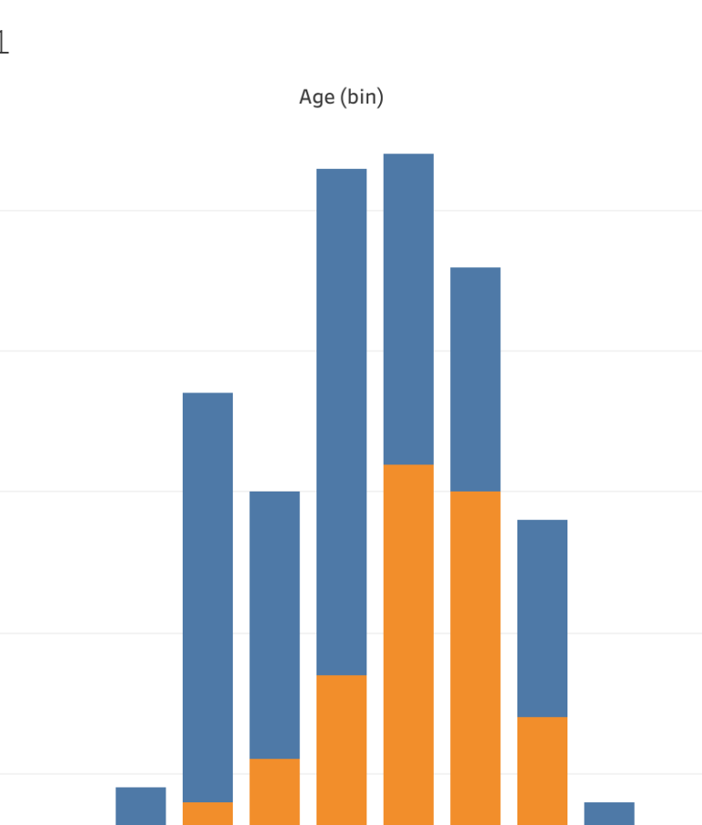
Looking at the Data
The Story Starts Here

Slide 6
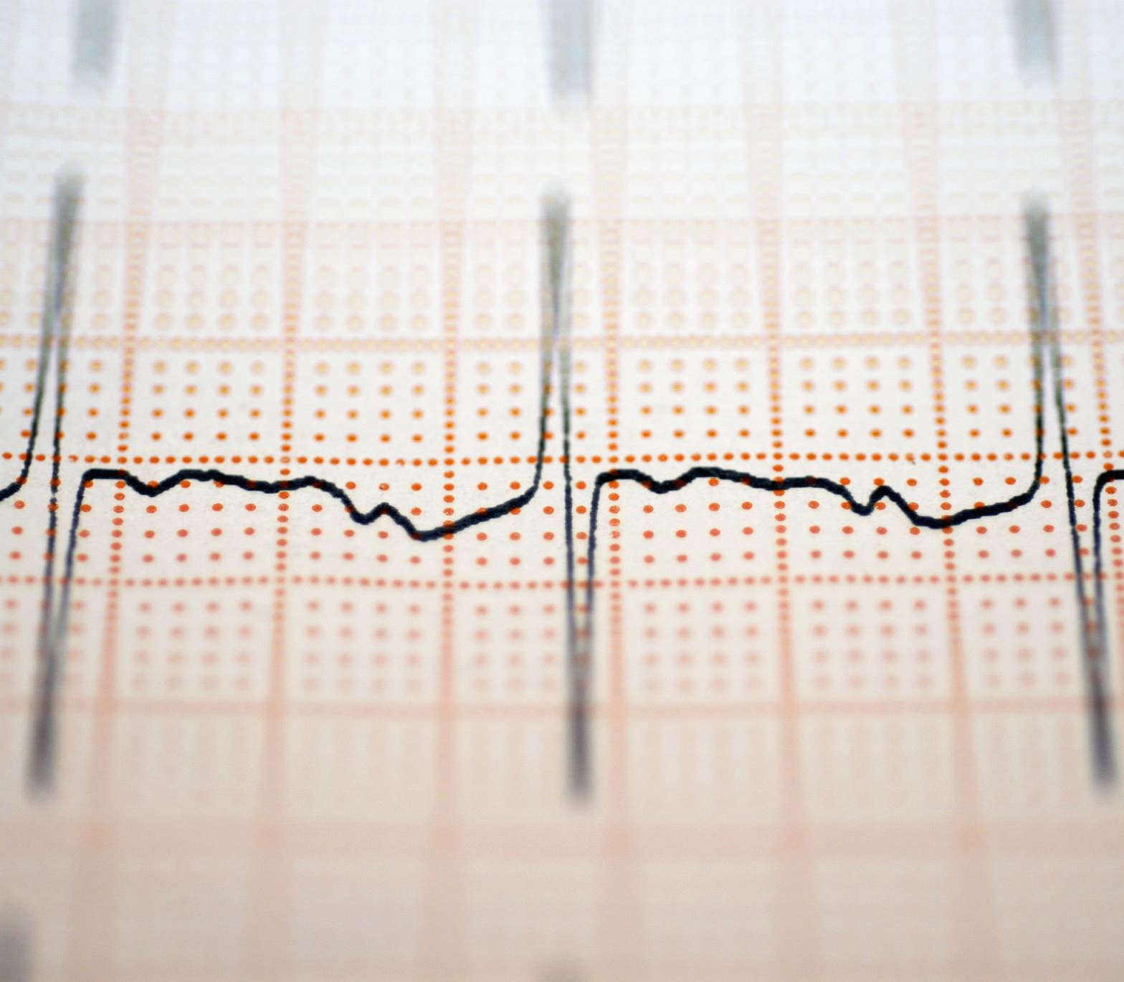
Multiple Models were created to determine which was the most effective to Predict Heart Disease
Supervised Learning Models:
Logistic Regression
Decision Tree
Random Forest
Support Vector Classifier (SVC)
Neural Networks:
Sequential
Keras Tuner

Slide 7
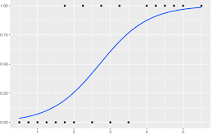
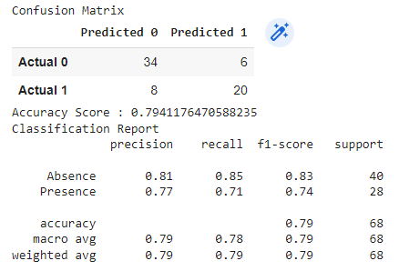
Logistic Regression
Logistic regression is a statistical method for predicting binary(0,1) outcomes from data.

Slide 8
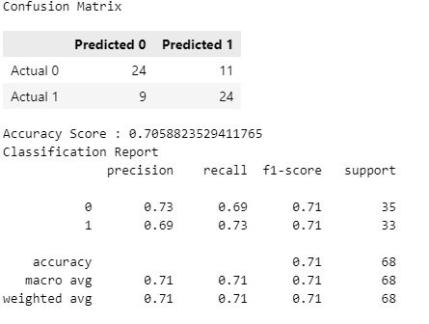
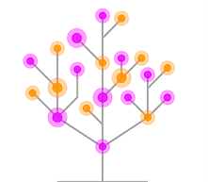
Decision Tree
A decision tree is a non-parametric supervised learning algorithm, which is utilized for both classification and regression tasks. It has a hierarchical, tree structure, which consists of a root node, branches, internal nodes and leaf nodes.

Slide 9
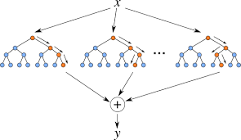
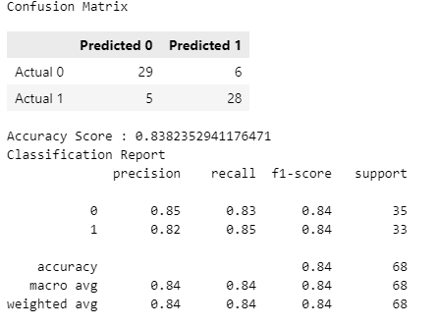
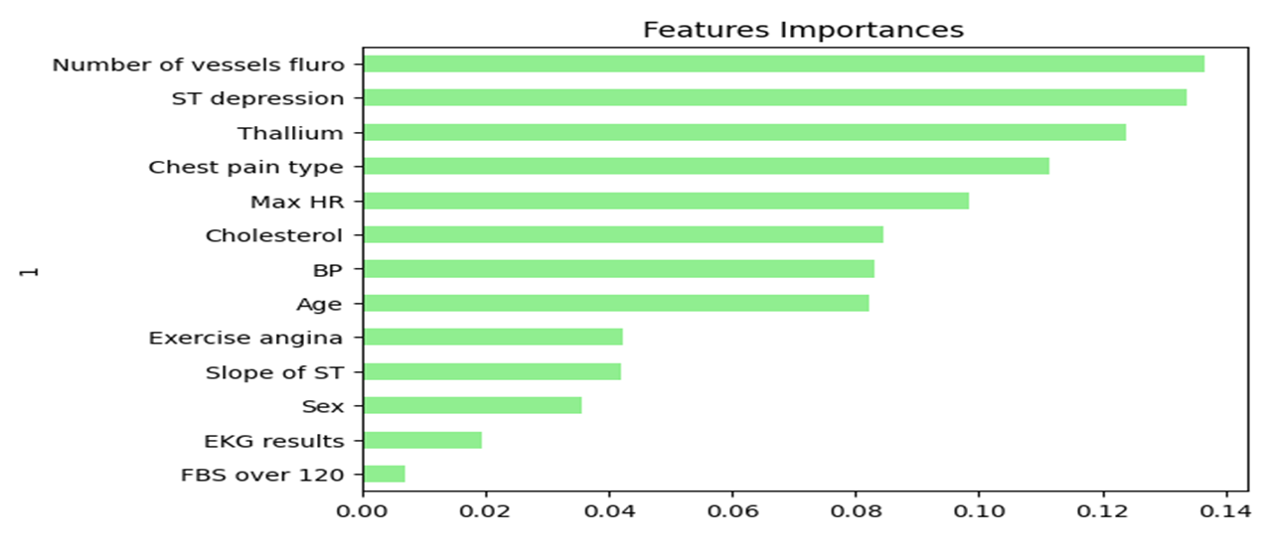
Random Forest
Random Forest is used for both classification and regression.

Slide 10
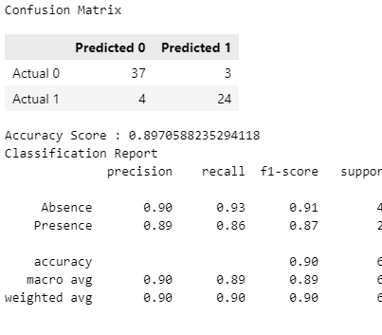
Support Vector Classifier (SVC)
SVC works by mapping data points to a high-dimensional space and then finding the optimal hyperplane that divides the data into two classes.

Slide 11
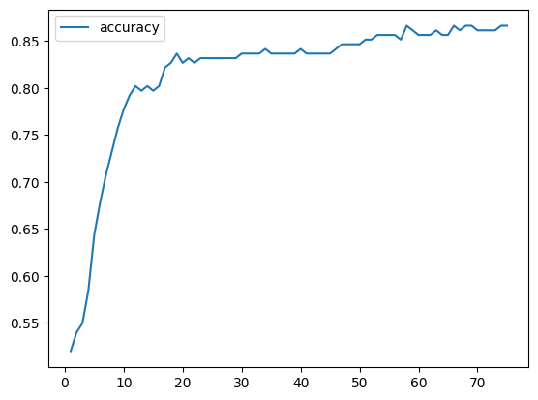
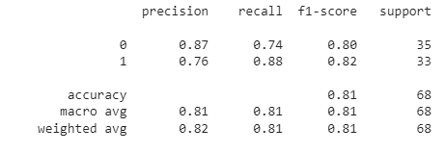
Sequential
A Sequential model is for plain stack of layers where each layer has exactly one input feature and one output target.

Slide 12
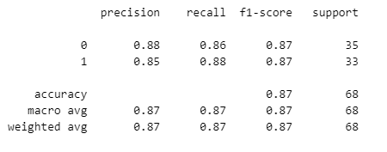
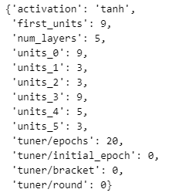
Keras Tuner
Keras Tuner is a library that helps pick the optimal set of hyperparameters.

Slide 13
Which Model would recommend to Predict Heart Disease
Support Vector Classifier results in the highest weighted F1 scores and the greatest Accuracy of all the models tested and is our Recommendation
F1 scores and Accuracy:
Support Vector Classifier (SVC)
.90
Keras Tuner - .87
Random Forest - .84
Sequential - .81
Logistic Regression - .79
Decision Tree - .71

Slide 14
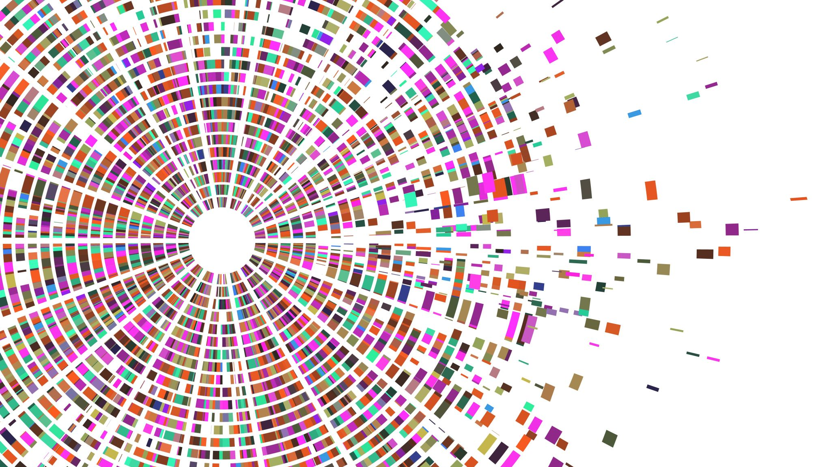
Thank You!
Q & A

